Slide 1




1917-1939
Chapter 22
LIFE IN COMMUNIST RUSSIA
life in communist russia
Strand Three: The History of Europe and the Wider World
@MsDoorley

Slide 2
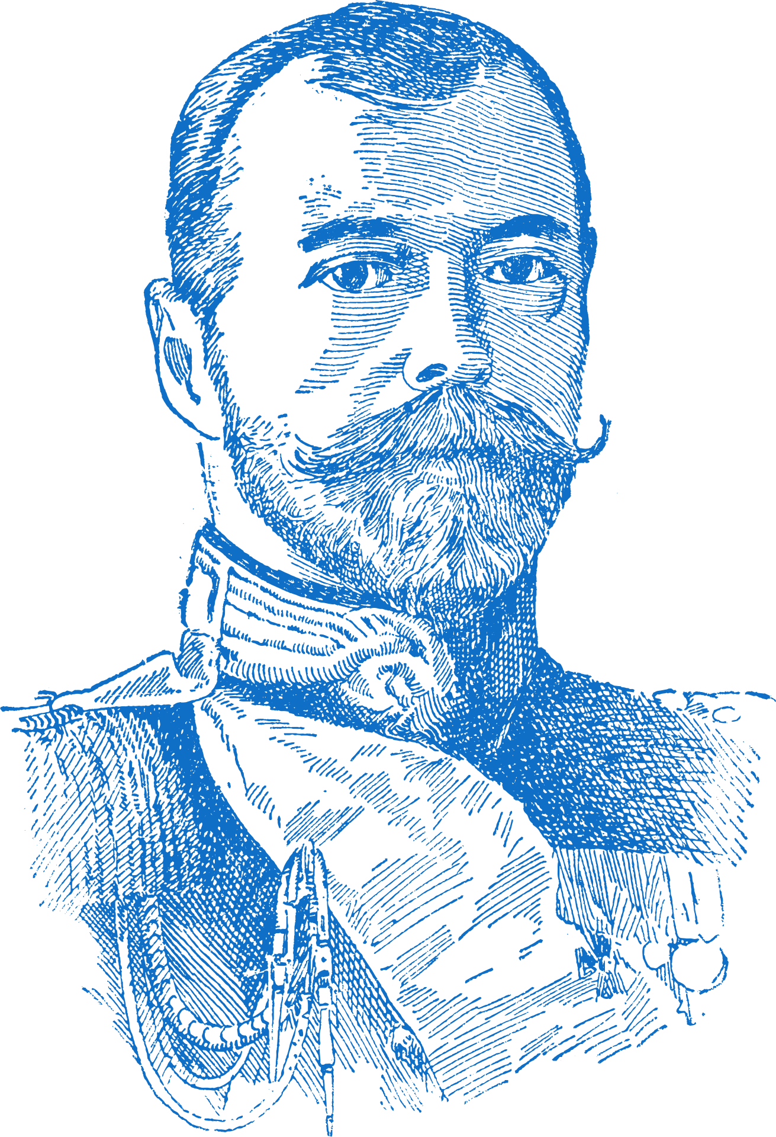
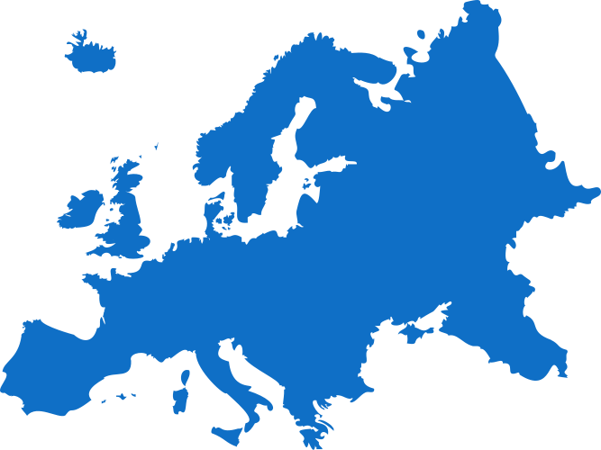
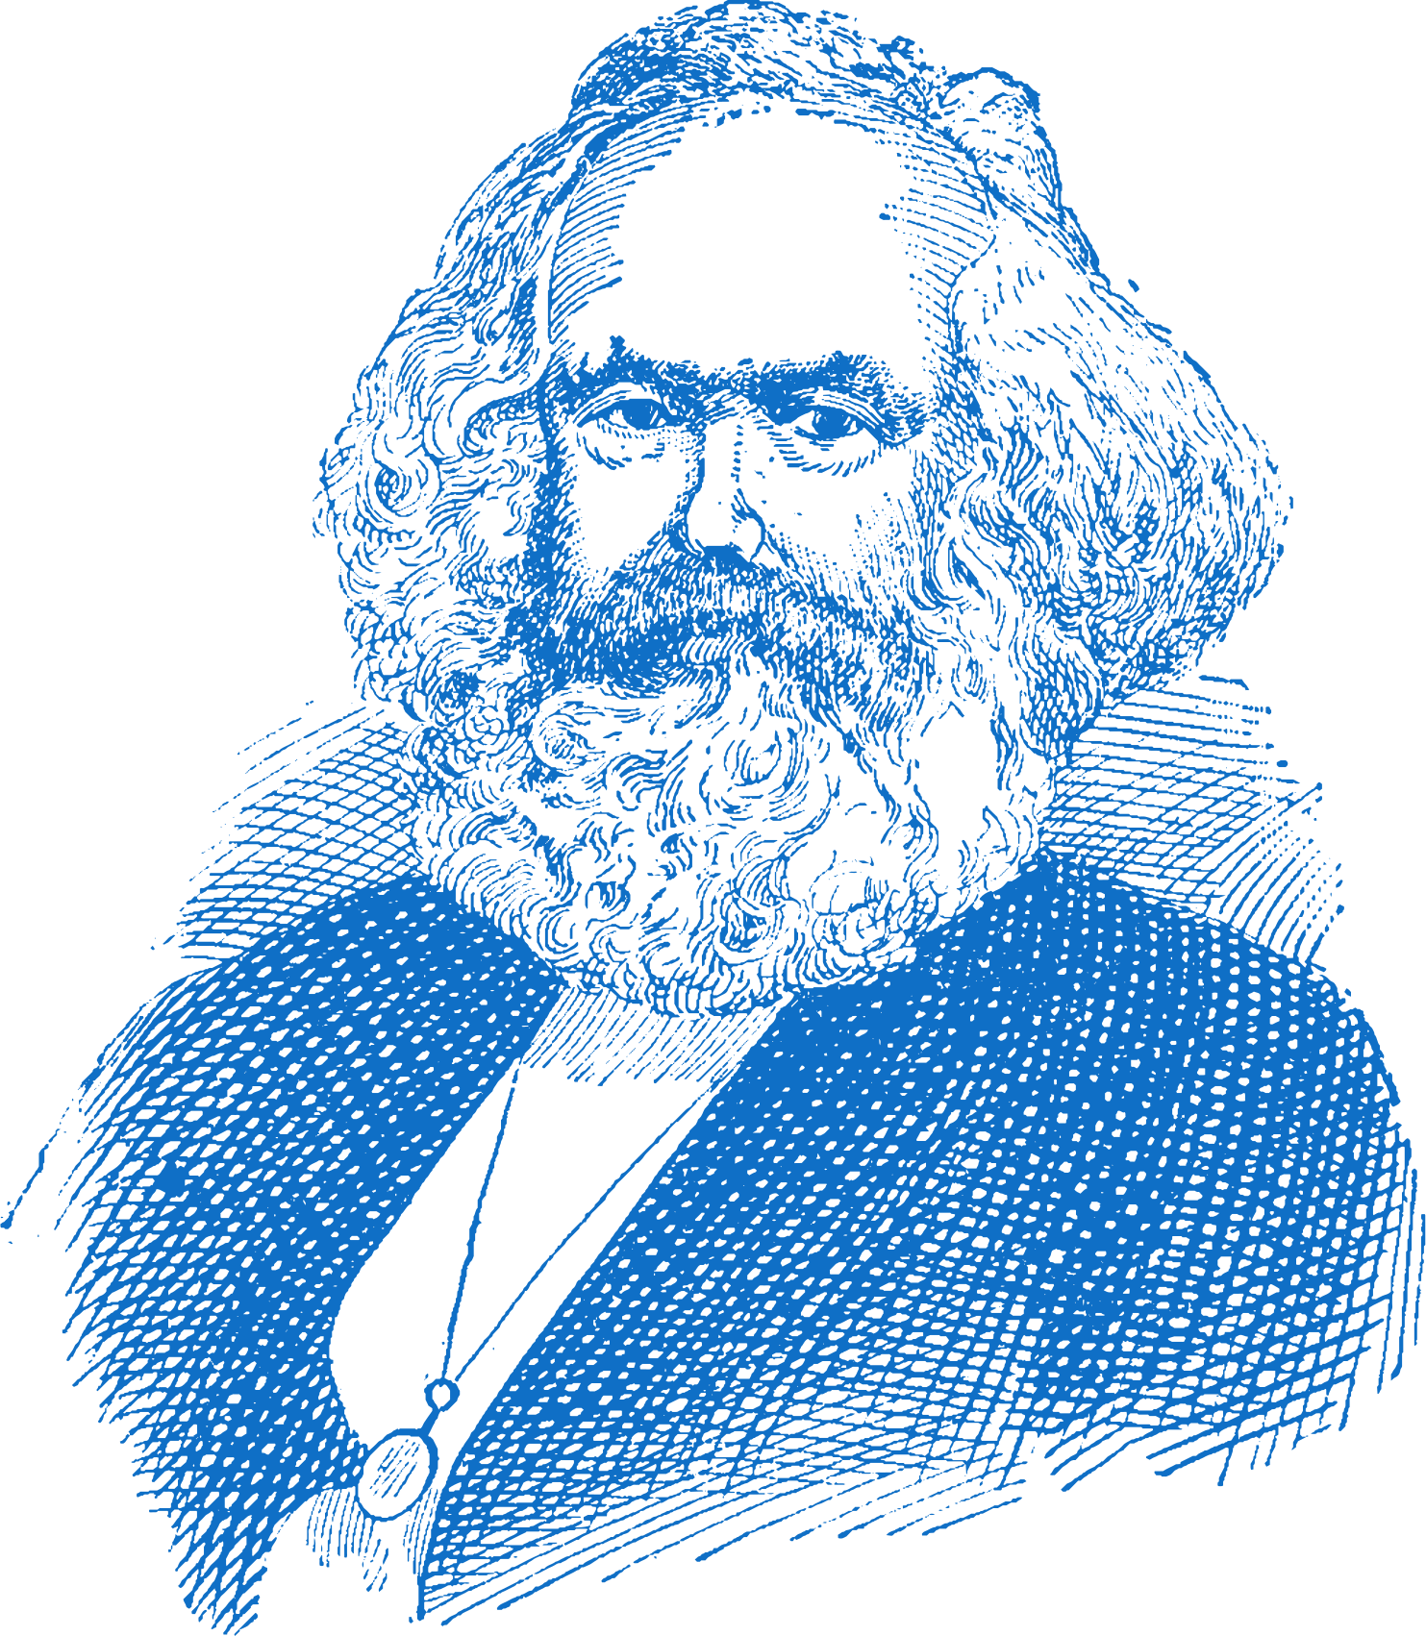
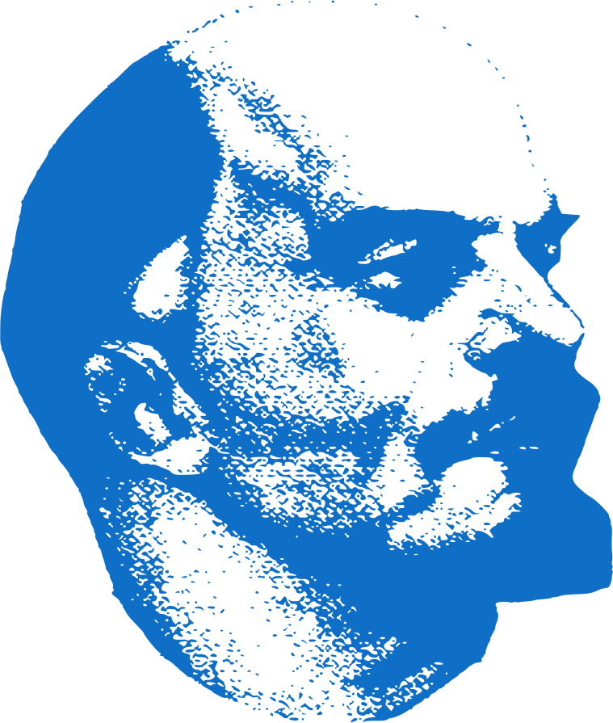
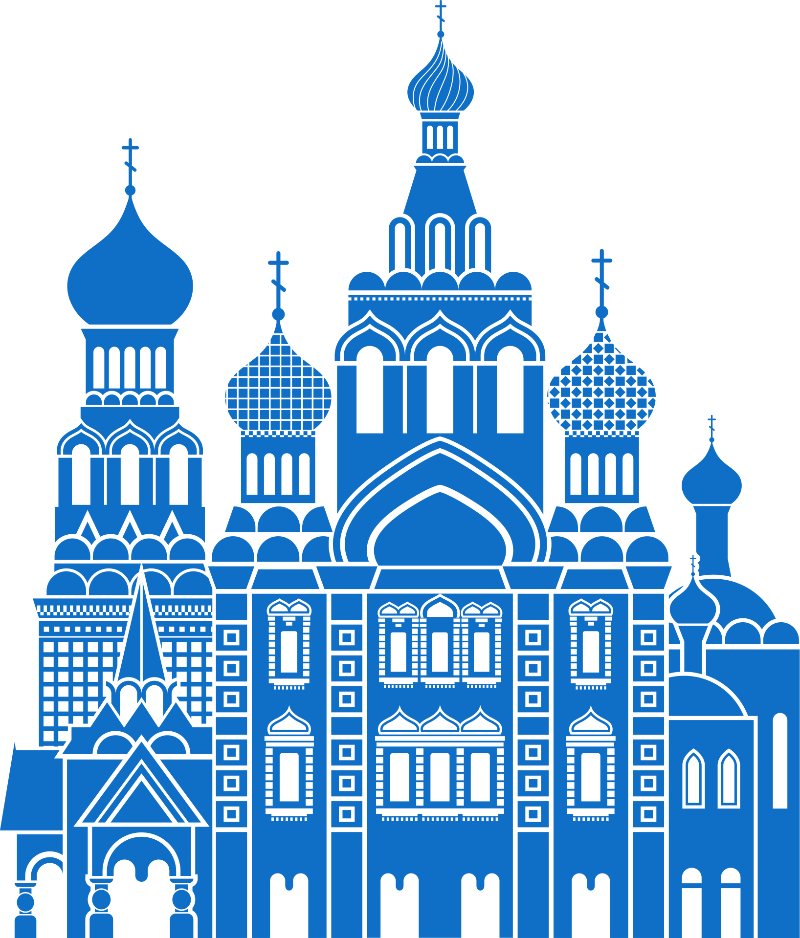
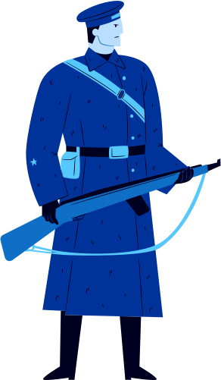
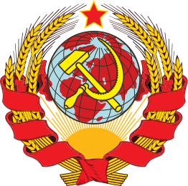
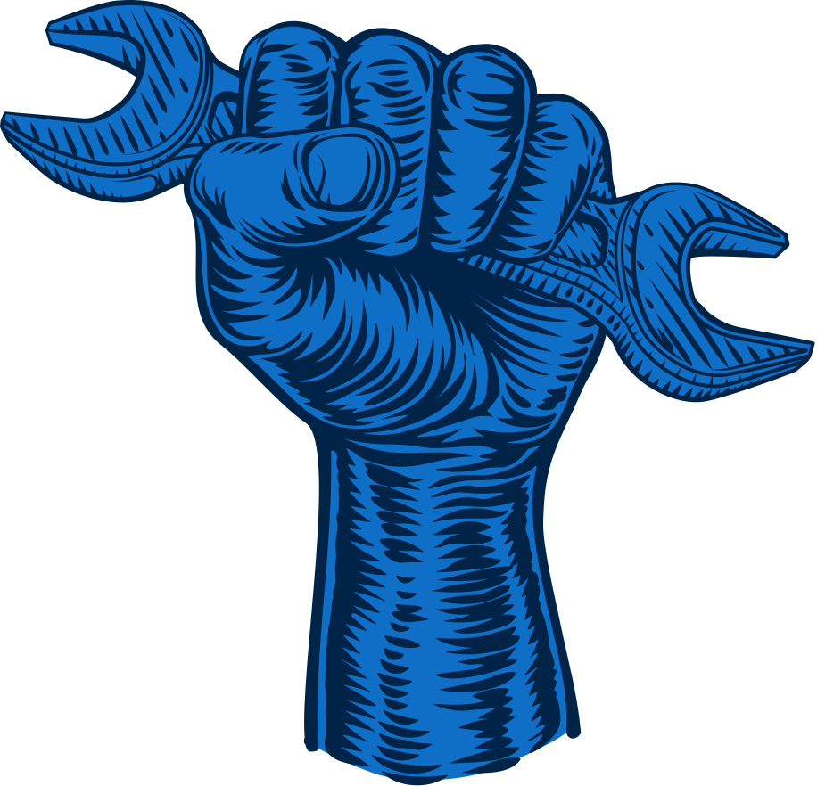
Chapter 22.1
LIFE IN LENIN'S RUSSIA
The Bolsheviks take control of Petrograd and Moscow, overthrowing the Provisional Government.
War Communism aimed to abolish private trade, control labour and nationalise all large scale industry
The New Economic Policy intended to introduce a temporary taste of capitalism in order to improve the economy.
Feb 1917
Oct 1917
Mar 1918
Jun 1918
Nov 1918
Mar 1921
Jan 1924
Strand Three: The History of Europe and the Wider World
Chapter Twenty-Two: Life in Communist Russia
The Romanov Family are ousted from power and a Provisional Government is put in place
Lenin's government sign the Treaty of Brest-Litovsk, removing Russia from the war.
Civil War took place between the Red Army and White Army.
Vladimir Lenin dies without a named successor.
@MsDoorley

Slide 3
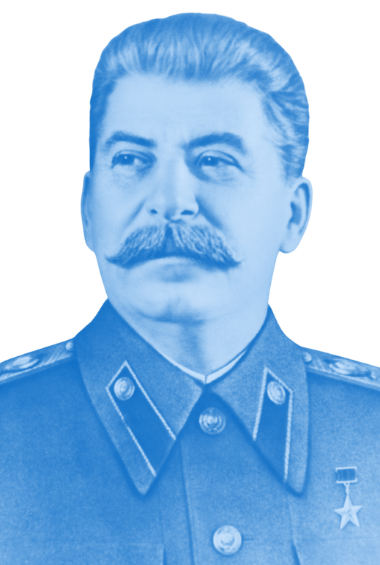
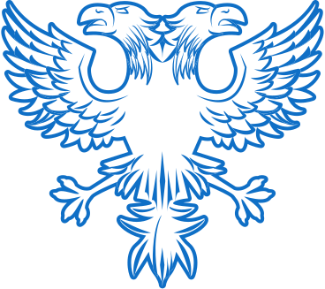
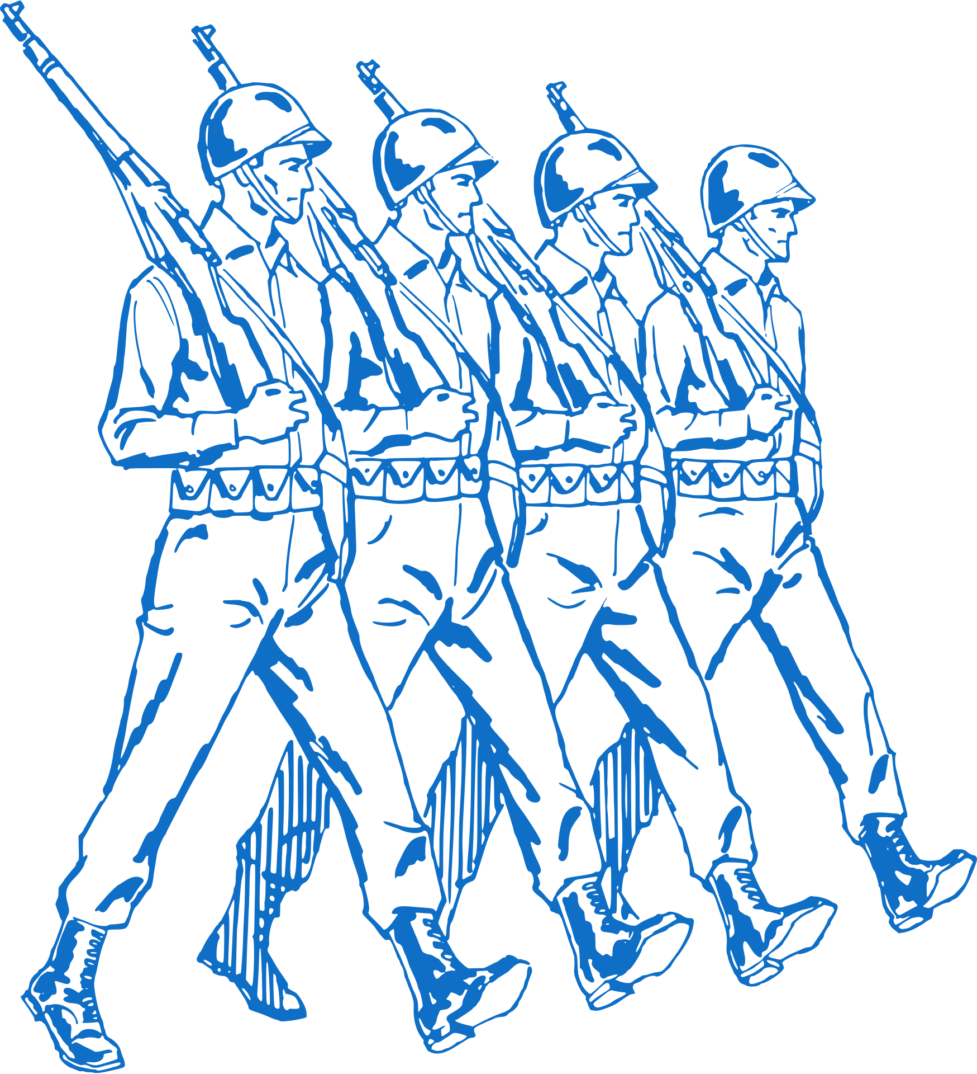
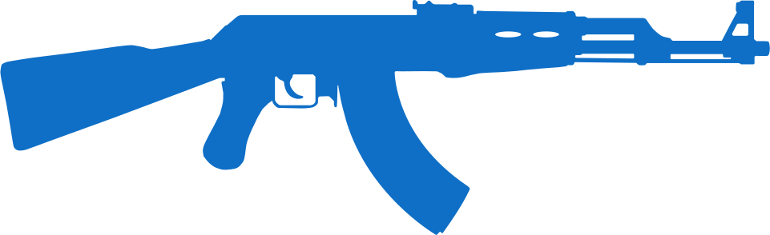
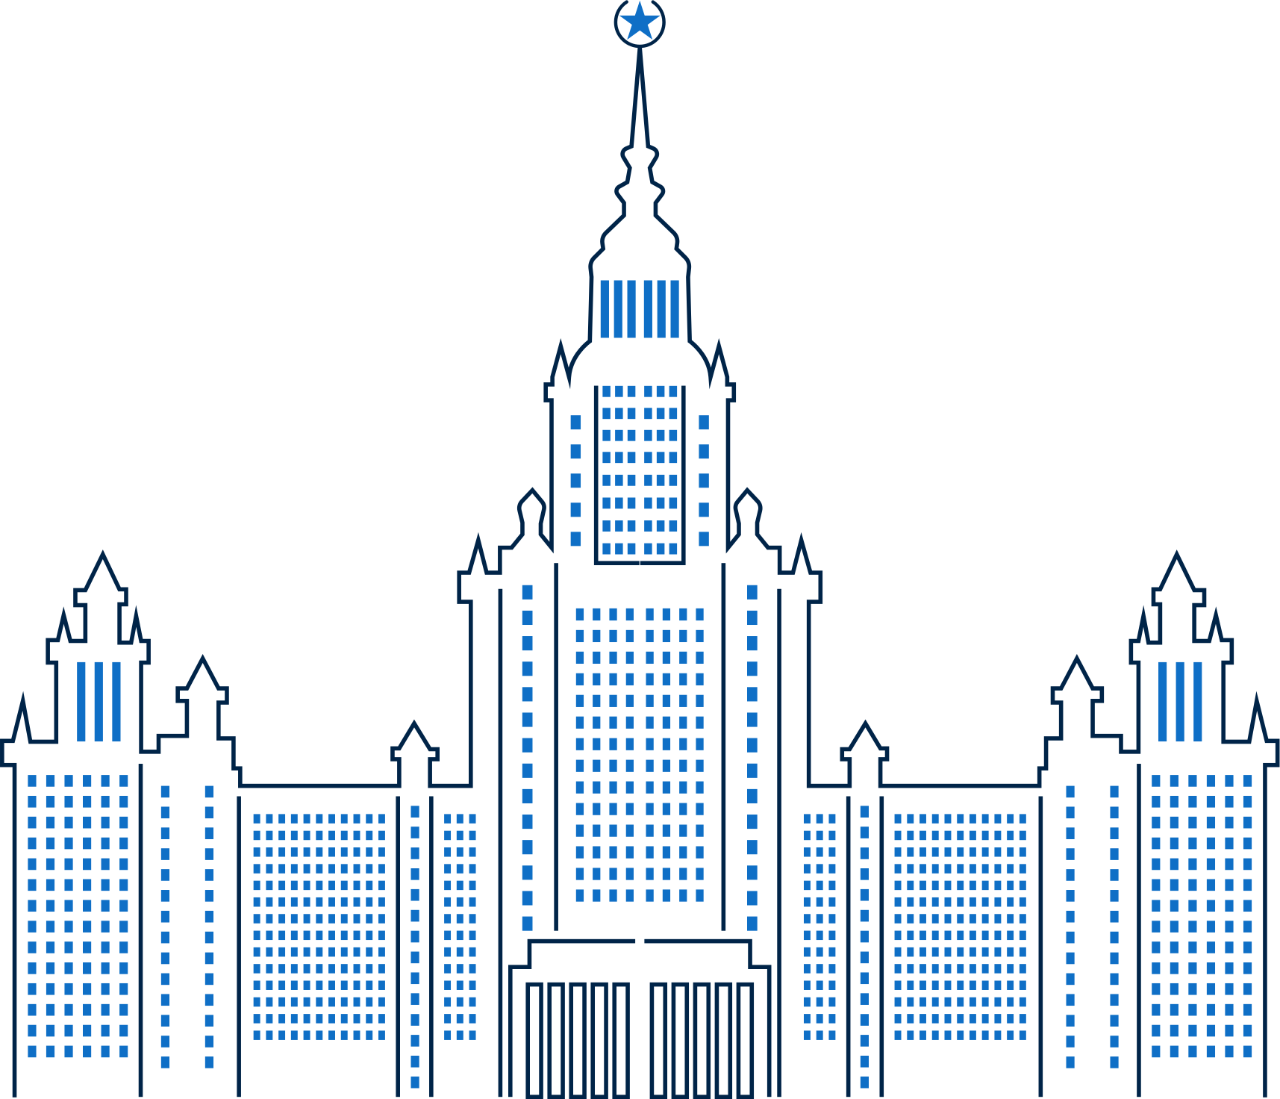
Chapter 22.2
LIFE IN STALIN'S RUSSIA
First Five Year Plan focused on heavy industry and the production of coal, oil, steel and electricity.
War Communism aimed to abolish private trade, control labour and nationalise all large scale industry
The first of the Concentration Camps are liberated by the Red Army.
1928
1933
1936
1941
Chapter Twenty-Two: Life in Communist Russia
Strand Three: The History of Europe and the Wider World
1945
1952
Jan 1924
Second Five Year Plan focused on transport and the production of consumer goods.
Russia joins World War II following Germany's Operation Barbarossa.
Stalin replaces Lenin as Leader of Soviet Russia.
@MsDoorley
Death of Josef Stalin

Slide 4
Learning Outcomes
3.9 EXAMINE life in one fascist country and one communist country in the twentieth century.
1.7 DEVELOP historical judgements based on evidence about personalities, issues and events in the past, showing awareness of historical significance.
1.9 DEMONSTRATE awareness of the significance of the history of Ireland and of Europe and the wider world across various dimensions, including political, social, economic, religious, cultural and scientific dimensions.
1.10 DEMONSTRATE chronological awareness by creating and maintaining timelines to locate personalities, issues and events in their appropriate historical eras.
Strand Three: The History of Europe and the Wider World
Chapter Twenty-Two: Life in Communist Russia
@MsDoorley

Slide 5
Introduction
After World War I, under the leadership of Vladimir Lenin, Russia became the first communist state. Josef Stalin took over from Lenin and used terror and propaganda to keep control and ensure that communism remained strong in Russia. Within a generation, Russia was transformed from a backwards, agricultural, peasant society to a more modern, industrial, urban one. However, it was the Russian people who paid a high price for this transformation.
Strand Three: The History of Europe and the Wider World
Chapter Twenty-Two: Life in Communist Russia
@MsDoorley

Slide 6
1917-1939
Chapter 22
22.1: COMMUNISM AND THE BOLSHEVIKS
22.1: communism and the bolsheviks
Strand Three: The History of Europe and the Wider World
@MsDoorley

Slide 7
Communism takes root in Russia
Russia’s poor performance in World War I prompted riots and strikes. Tsar Nicholas II of the Romanov Dynasty was forced to step down in February 1917 and replaced by a Provisional Government during the February Revolution. The Provisional Government was overthrown by Vladimir Lenin during the October Revolution of 1917 when the Provisional government failed to pull Russia out of the war. The Tsar and his family were imprisoned in a house far from the capital.
Lenin and his followers were known as the Bolsheviks. The Bolshevik Party believed in the ideas of Karl Marx, a German political thinker, who wanted to make society ‘classless’; the working classes should stage revolutions to end private ownership and distribute wealth. This was communism; a system of government where the state controls all aspects of the economy (property, business and jobs) and of society, with limited rights for individuals. Religion was also discouraged, with Church property seized.
Strand Three: The History of Europe and the Wider World
Chapter Twenty-Two: Life in Communist Russia
@MsDoorley

Slide 8
The First Communist State
Russia became the world’s first communist state. All political parties other than the Bolshevik Party were banned. The government took control of the banks, factories and farms. Lenin was made a dictator. He negotiated a peace treaty with Germany that ended Russia’s involvement in World War I (the Treaty of Brest-Litovsk).
Strand Three: The History of Europe and the Wider World
Chapter Twenty-Two: Life in Communist Russia
"Workers of the world, unite! You have nothing to lose but your chains"
Karl Marx
@MsDoorley

Slide 9
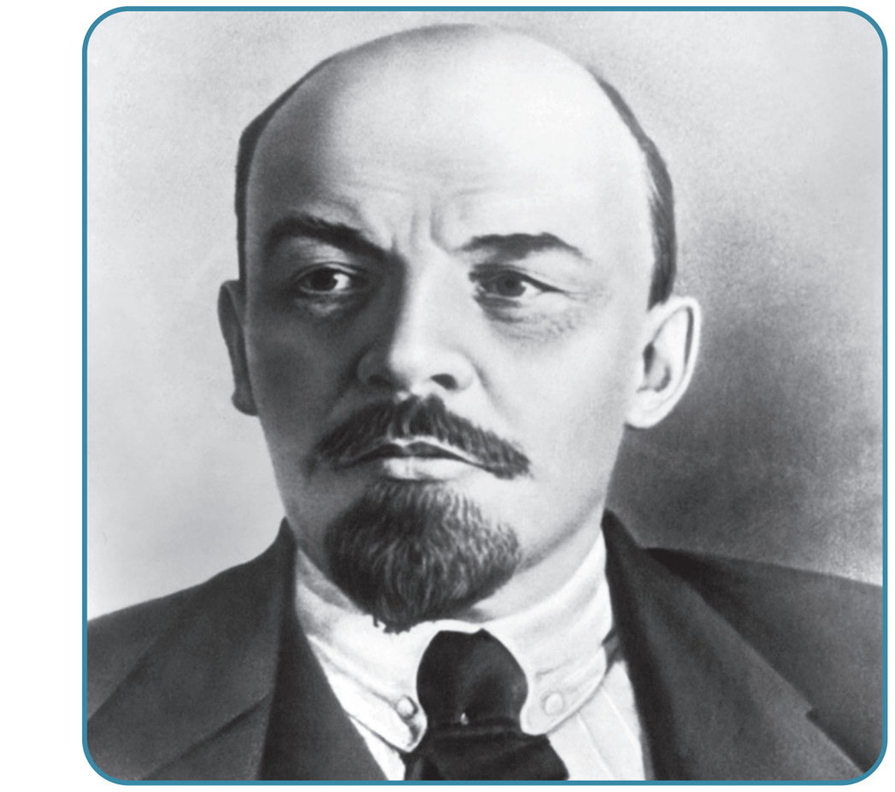
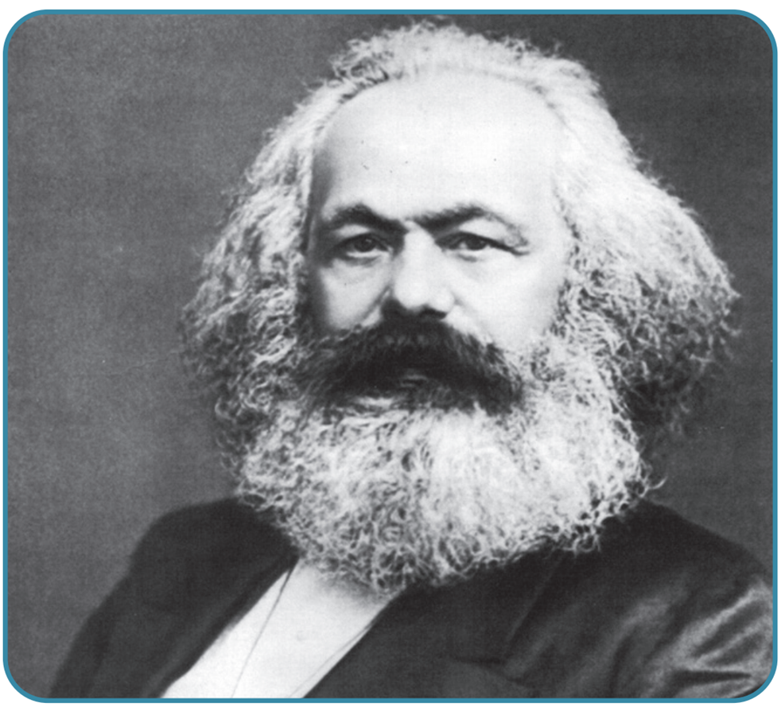
Strand Three: The History of Europe and the Wider World
Chapter Twenty-Two: Life in Communist Russia
Diagram taken from Artefact, 2nd Edition by Eimear Jenkinson and Gregg O'Neill (educate.ie)
@MsDoorley

Slide 10
The Russian Civil War
Many Russians were worried by the events following Lenin’s rise to power. In December 1917, civil war broke out. The Bolsheviks’ Red Army, under the command of Leon Trotsky, fought the White Army (an alliance of various anti-communist groups.) In July 1918, Tsar Nicholas II, his wife and their five children were executed by the Bolsheviks in the house where they had been imprisoned.
The Bolsheviks’ secret police (the Cheka) ‘removed’ any person who was an actual (or potential) threat to the government – ‘enemies of the state’. In St Petersburg alone, the Cheka killed 800 people during a period known as ‘The Red Terror’.
By 1921, Lenin and the Bolsheviks had gained control of the country, with the remnants of the White Army defeated in 1922. Russia was renamed the Union of Soviet Socialist Republics (USSR). ‘Soviet’ originally meant a workers’ council, in Russian.
Strand Three: The History of Europe and the Wider World
Chapter Twenty-Two: Life in Communist Russia
@MsDoorley

Slide 11
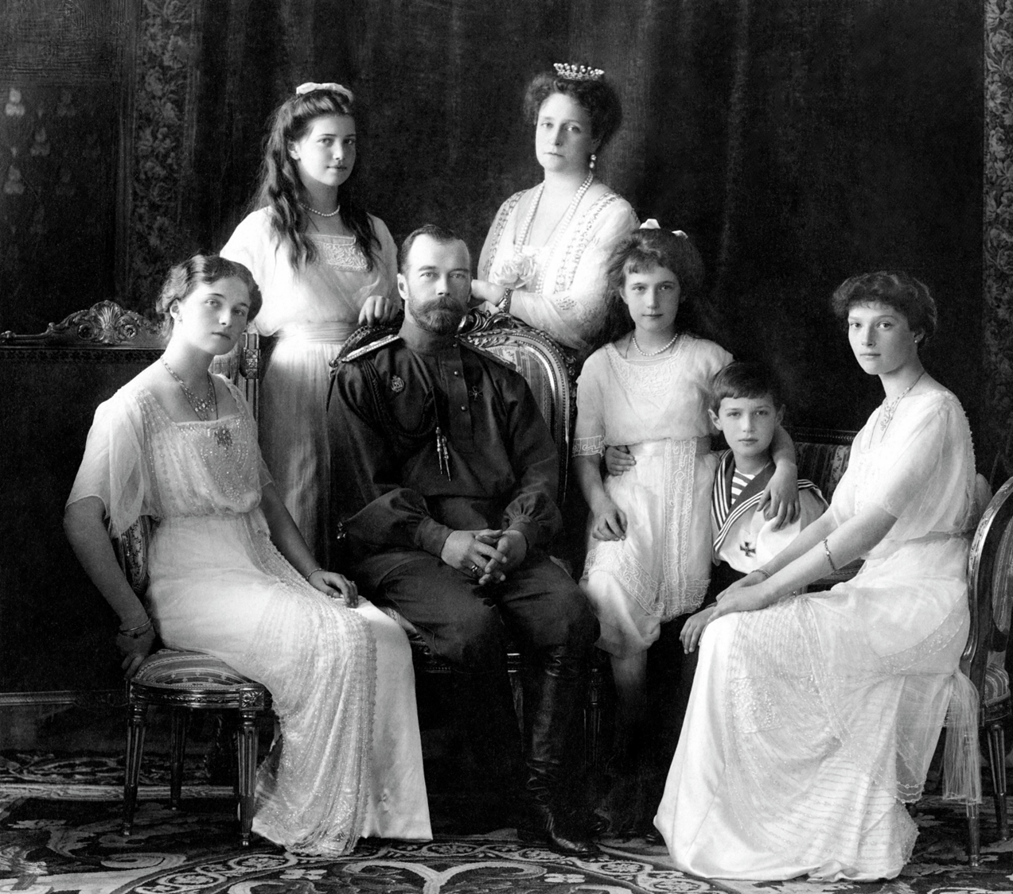
The Romanov family
(from left to right)
Olga (22)
Maria (19)
Nicholas II (50)
Alexandra (46)
Anastasia (17)
Alexei (13)
Tatiana (21)
Strand Three: The History of Europe and the Wider World
Chapter Twenty-Two: Life in Communist Russia
Diagram taken from Artefact, 2nd Edition by Eimear Jenkinson and Gregg O'Neill (educate.ie)
@MsDoorley

Slide 12
Life Under Lenin
War Communism was where Lenin took all factories into state ownership (Nationalisation) and forced farmers to give all extra food to the state. The people didn’t like Lenin’s economic strategies and so:
  The farmers rebelled by not producing extra food, famine followed.
  The factory workers rebelled by not working to full potential.
Lenin was forced to change policies and introduced the New Economic Policy. This meant
  Factories were given back to owners and give workers bonuses for working hard.
  Peasant farmers were paid for extra food but charge tax on the income.
Strand Three: The History of Europe and the Wider World
Chapter Twenty-Two: Life in Communist Russia
@MsDoorley

Slide 13
Women’s Lives Under Lenin
Marx had insisted on the equality of men and women in communist society. Under Lenin, the status of Russian women improved a lot:
  They got the vote and the right to education
  They could access contraception and divorce
  They could legally be head of the household
  All jobs were open to women (theoretically)
  Cheap dining halls, laundries and childcare were provided by the state so that traditional responsibilities would not prevent women working or getting involved in this new society.
Strand Three: The History of Europe and the Wider World
Chapter Twenty-Two: Life in Communist Russia
@MsDoorley

Slide 14
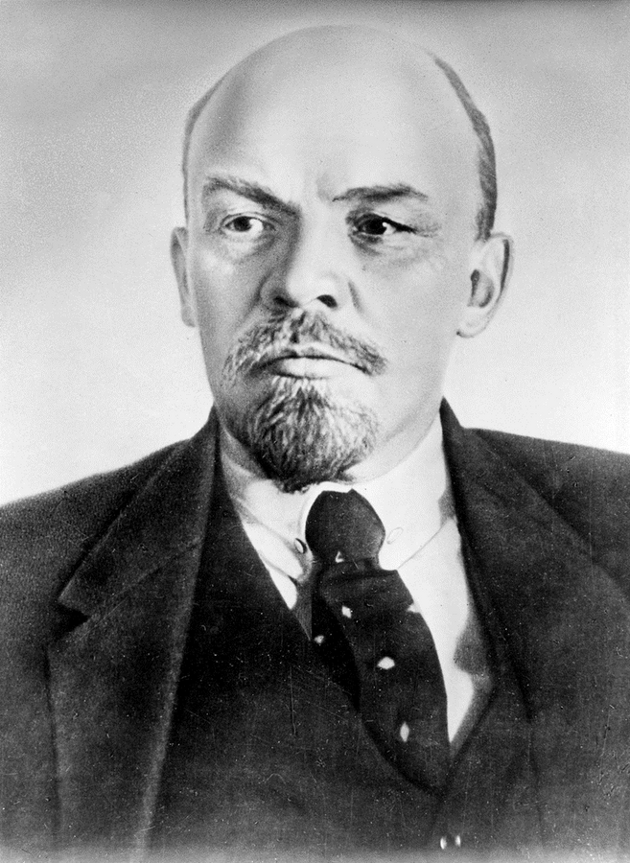
Vladimir Lenin, 1870-1924
Vladimir Lenin was born in Simbirsk, Russia. He grew up in a middle-class family and went on to study law at Kazan University but was expelled due to his involvement in radical activities. Lenin became deeply interested in Marxist theory in the 1890s and authored the work "What is to be Done?" in 1902, arguing for a professional revolutionary party. He played a pivotal role in the formation of the Russian Social-Democratic Labour Party and later led its Bolshevik faction. Following the 1917 February Revolution, he returned to Russia from his exile in Switzerland. Under his leadership, the Bolsheviks seized power during the October Revolution of 1917. As the head of the new Soviet government, Lenin faced the Russian Civil War and introduced the New Economic Policy (NEP) in 1921 to revitalize the economy. He survived an assassination attempt in 1918 which significantly impacted his health. His later years saw increasing tensions with fellow Bolshevik leaders, particularly Joseph Stalin. Lenin passed away in 1924 and was succeeded by Stalin. He was embalmed and his body is displayed in Moscow's Red Square at the Lenin Mausoleum.
Strand Three: The History of Europe and the Wider World
Chapter Twenty-Two: Life in Communist Russia
Diagram taken from Artefact, 2nd Edition by Eimear Jenkinson and Gregg O'Neill (educate.ie)
@MsDoorley

Slide 15
Checkpoint pg. 295 (Artefact, 2nd Edition)
  Explain the following terms: communism; Bolsheviks; the Cheka.
  Who was (a) Karl Marx; (b) Vladimir Lenin; (c) Leon Trotsky?
  How did Lenin come to power in 1917?
  List two changes Lenin and the Bolsheviks made once in power.
  What was the outcome of the Russian Civil War.
Strand Three: The History of Europe and the Wider World
Chapter Twenty-Two: Life in Communist Russia
@MsDoorley

Slide 16
Checkpoint pg. 295 (Artefact, 2nd Edition)
1. Communism: a system of government where the state controls all aspects of the economy(property, business and jobs) and of society, with limited rights for individuals.
2. (a) Karl Marx: a German political thinker who said that the working classes should stage revolutions to end private ownership and distribute wealth, making society ‘classless’
(b) Vladimir Lenin: leader of the Bolshevik party
(c) Leon Trotsky: commander of the Bolshevik Red Army.
3. Lenin came to power in 1917 by overthrowing the provisional government in the October Revolution.
4. Any two of: all political parties other than the Bolshevik Party were banned; the government took control of the banks and factories; a peace treaty was agreed with Germany, ending Russia’s involvement in World War I.
5. By 1921, Lenin and the Bolsheviks had gained control of the country and the last clusters of the White Army were defeated in 1922. Russia was renamed the Union of Soviet Socialist Republics (USSR).
Strand Three: The History of Europe and the Wider World
Chapter Twenty-Two: Life in Communist Russia
@MsDoorley

Slide 17
1917-1939
Chapter 22
22.2: STALIN'S RISE TO POWER
22.2: stalin's rise to power
Strand Three: The History of Europe and the Wider World
@MsDoorley

Slide 18
Lenin's Death
In 1918, Lenin narrowly survived an assassination attempt, but was severely wounded. His long term health was affected (lead poisoning), and in 1922 he suffered two strokes from which he never fully recovered. In his declining years, he worried about the bureaucratisation of the regime and also expressed concern over the increasing power of his eventual successor Joseph Stalin. He wrote his Testament, a document outlining his vision for the future of communism. It also contained his thoughts on each of his colleagues. He was very critical of Josef Stalin, who had been appointed General Secretary of the Communist Party in 1922 – Lenin wanted Stalin removed from his position. Lenin died on 24 January 1924, without a named successor. His corpse was embalmed and placed in a mausoleum on Moscow's Red Square. A power struggle began amongst the senior members of the party: Lev Kamenev, Grigory Zinoviev, Nikolai Bukharin, Leon Trotsky and Josef Stalin.
Strand Three: The History of Europe and the Wider World
Chapter Twenty-Two: Life in Communist Russia
@MsDoorley

Slide 19
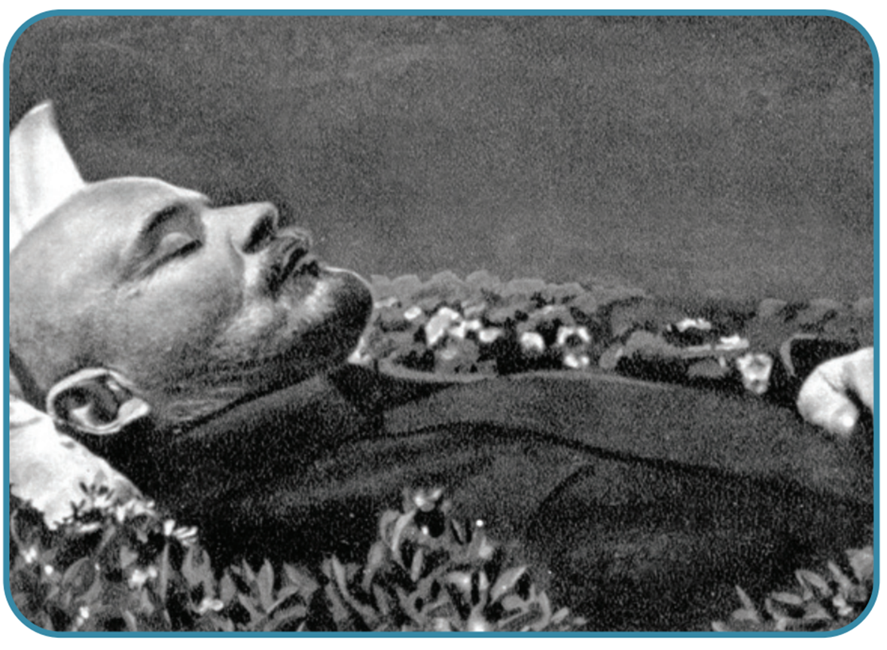
Strand Three: The History of Europe and the Wider World
Chapter Twenty-Two: Life in Communist Russia
Diagram taken from Artefact, 2nd Edition by Eimear Jenkinson and Gregg O'Neill (educate.ie)
@MsDoorley

Slide 20
Stalin's Rise to Power
  Leon Trotsky was the frontrunner for the leadership of the Communist Party.
  He was well liked by the ordinary party members and had been successful during the Civil War. Lenin had also described Trotsky as the ‘most capable’.
  However, many of the other leaders in the party viewed Trotsky as arrogant and feared that he already controlled the Red Army, meaning he would have too much power as leader.
  Stalin took control of Lenin’s funeral arrangements and gave the speech, leading people to believe that he was to Lenin’s successor.
  Stalin played the various party leaders against each other. He used Kamenev and Zinoviev to expel Trotsky from the party and the country in 1929. Stalin would later order Trotsky’s assassination in 1939.
  Stalin then turned on Kamenev and Zinoviev, forced them out of their government position and replaced them with his supporters.
  Stalin announced his policy of Socialism in One Country: the plan to first strengthen communism in the USSR before spreading it further afield. By 1928, Stalin was the absolute ruler of the USSR. Over the next twenty-six years, he would consolidate his power ruthlessly until his death in 1953.
Strand Three: The History of Europe and the Wider World
Chapter Twenty-Two: Life in Communist Russia
@MsDoorley

Slide 21
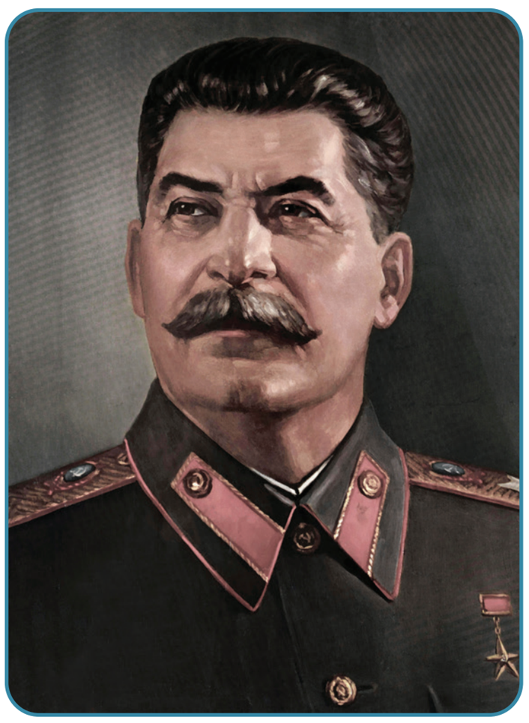
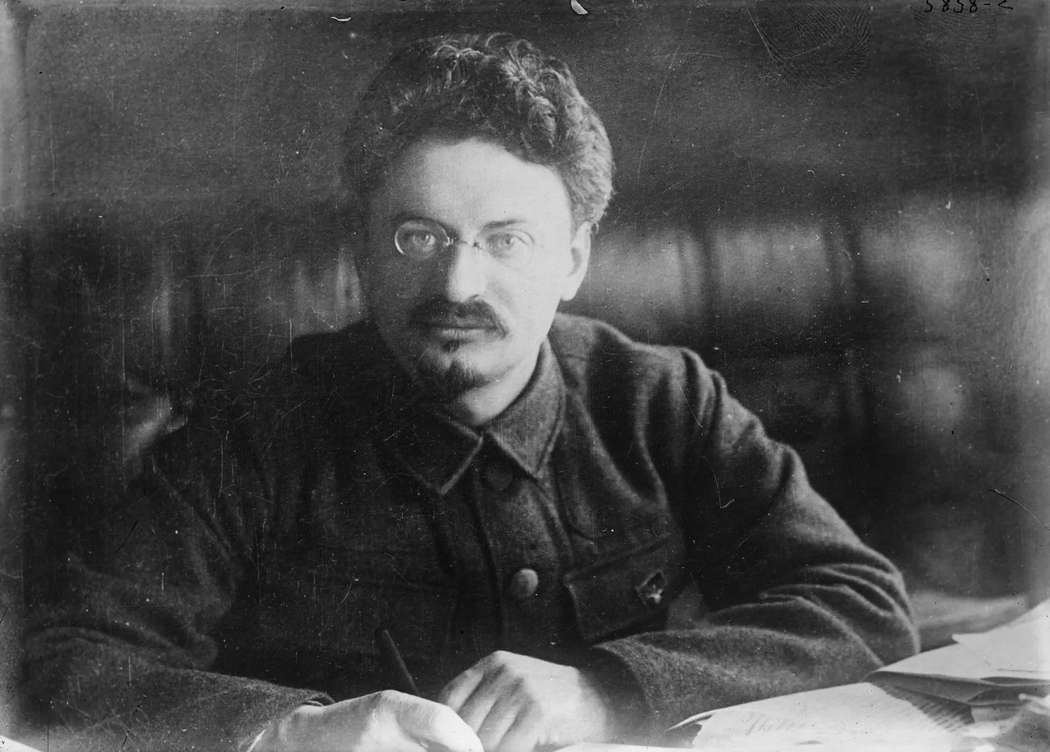
Strand Three: The History of Europe and the Wider World
Chapter Twenty-Two: Life in Communist Russia
Diagram taken from Artefact, 2nd Edition by Eimear Jenkinson and Gregg O'Neill (educate.ie)
@MsDoorley

Slide 22
Checkpoint pg. 297 (Artefact, 2nd Edition)
  What was Lenin’s Testament?
  Why was Trotsky seen as the likely successor to Lenin? Why were some people opposed to him?
  How did Stalin eventually seize power?
  What was Socialism in One Country?
Strand Three: The History of Europe and the Wider World
Chapter Twenty-Two: Life in Communist Russia
@MsDoorley

Slide 23
Checkpoint pg. 297 (Artefact, 2nd Edition)
  Lenin’s Testament was a document outlining his vision for the future of communism.
  Trotsky was seen as the likely successor to Lenin because he was well liked by the ordinary party members and had been successful during the civil war. In his Testament, Lenin had also described Trotsky as the ‘most capable’. Some people were opposed to him as they saw Trotsky as arrogant and were worried that he already controlled the Red Army and would have too much power as leader.
  Stalin eventually seized power by playing the various party members off against each other. He used Kamenev and Zinoviev to expel Trotsky from the party and the country.
  ‘Socialism in One Country’ was Stalin’s plan to first strengthen communism in the USSR before spreading it further afield.
Strand Three: The History of Europe and the Wider World
Chapter Twenty-Two: Life in Communist Russia
@MsDoorley

Slide 24
1917-1939
Chapter 22
22.3: LIFE IN STALIN'S RUSSIA
22.3: life in stalin's russia
Strand Three: The History of Europe and the Wider World
@MsDoorley

Slide 25
Economic Policies
Stalin's economic policies greatly affected the lives of millions of people.
  In 1927, Stalin started a scheme called collectivisation (the joining of small, unproductive farms together to create large, state-owned farms). Workers would be hired to run them or farmers could collectively own all the land and equipment. However, the farmers refused to surrender their farms. Over 2.5 million kulaks (wealthy independent farmers) were simply removed and sent to the gulags (forced labour camps). By 1936, 90% of farmland had been collectivised.
  Stalin launched three Five-Year Plans to boost industrialisation. A Five Year Plan was a set of targets (and policies designed to meet them) over a period of five years. He believed the USSR was up to 100 years behind other industrialised countries such as Britain and Germany.
  The First Five Year Plan (1928-1932) focused on heavy industry and the production of coal, oil, steel and electricity. The targets were mostly unrealistic but improvements were made.
  The Second Five Year Plan (1933-1937) had a continued focus on industry but also on transport and the production of consumer goods. The Moscow Underground was built as were canals and rail links.
  The Third Five Year Plan (1938-1941) was cut short due to the 1941 invasion by Germany. Instead, the focus switched to the production of arms and ammunition.
  Shortages of everyday goods were widespread and food had to be rationed. Some regions were devasted by famines.
  Rewards such as higher wages were given to the most productive workers.
  Many workers were provided with an apartment, free schooling and free basic healthcare.
Strand Three: The History of Europe and the Wider World
Chapter Twenty-Two: Life in Communist Russia
@MsDoorley

Slide 26
Results of Stalin’s Economic Policies
  Electricity – 5m k/w (1927) up to 36m k/w (1937)
  Coal – 35m tonnes (1927) up to 128m tonnes (1937)
  Oil – 12m tonnes (1927) up to 47m tonnes (1937)
  Steel – 4m tonnes (1927) up to 18m tonnes (1937)
  The USSR became the World’s 2nd Strongest Industrial Power, leap jumping Germany
  New cities, dams, Moscow underground, health service, education and no unemployment
  Industrial accidents, punishments & labour camps, slave labour, no human rights, no consumer goods.
Strand Three: The History of Europe and the Wider World
Chapter Twenty-Two: Life in Communist Russia
@MsDoorley

Slide 27
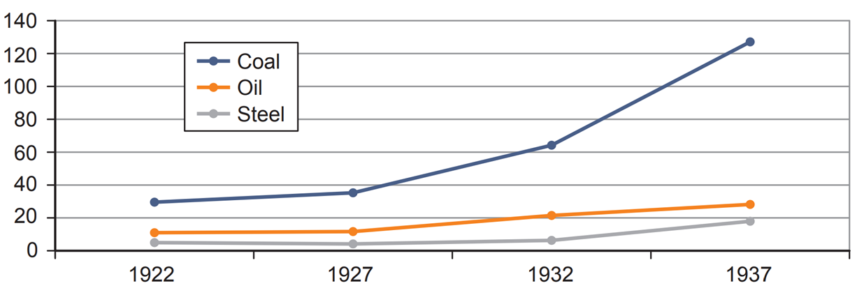
Strand Three: The History of Europe and the Wider World
Chapter Twenty-Two: Life in Communist Russia
Diagram taken from Artefact, 2nd Edition by Eimear Jenkinson and Gregg O'Neill (educate.ie)
@MsDoorley

Slide 28
Terror
Stalin wanted to keep his grip on his power through the use of terror which would become a part of life in the USSR. He had become a dictator of a totalitarian state (form of government that attempts to assert total control over the lives of its citizens).
  In 1934, the Cheka were reorganised and renamed the NKVD. They arrested (tortured or executed) ‘enemies of the state’. Suspicion and fear reigned as people were encouraged to report anybody that they suspected to the NKVD. Where have we seen this before?
  The NKVD were also responsible for running the gulags. There were over 30,000 gulags in existence across the USSR but the largest camps lay in the most extreme climatic regions of the country such as Siberia. Prisoners were forced to carry out manual work such as felling trees, mining or building railroads. The combination of violence, extreme climates, hard labour, poor food rations and unsanitary conditions led to extremely high death rates. Over one million people died in the gulags between 1934 and 1953.
Strand Three: The History of Europe and the Wider World
Chapter Twenty-Two: Life in Communist Russia
@MsDoorley

Slide 29
The Purge and the Show Trials
Stalin became increasingly paranoid that people were trying to overthrow him. In 1934, he began a purge of his party, removing all those who he believed were challenging his authority. That year alone, almost one million members were expelled from the Communist Party.
Stalin organised three political show trials between 1936 and 1938. A show trial was a staged trial held in public to influence popular opinion. It was a method of propaganda so the press were invited to attended. The defendants had been tortured for their confessions while their families had been threatened with arrest and torture. Stalin is rumoured to have watched the show trials from behind a screen.
Strand Three: The History of Europe and the Wider World
Chapter Twenty-Two: Life in Communist Russia
@MsDoorley

Slide 30
The First Show Trial (1936)
The first show trial was held in August 1936. It became known as the Trial of the Sixteen because 16 Communist leaders (including Kamenev and Zinoviev) were tried for the assassination of Sergei Kirov. They were also accused of attempting to murder Stalin, Lenin and others in order to overthrow the Government. All 16 defendants pleaded guilty and were all executed within 24 hours of the verdict, despite Stalin promising their lives would be spared if the pleaded guilty and blamed Trotsky. Their family members were killed or exiled as well.
Strand Three: The History of Europe and the Wider World
Chapter Twenty-Two: Life in Communist Russia
@MsDoorley

Slide 31
The Second Show Trial (1937)
The second show trial was held in January 1937 and was known as the Trial of the Seventeen. It saw 17 current and former Bolshevik leaders tried. The principal defendants were Pyatakov (former industry minister) and Radek (a leading member of the Trotskyist opposition). Most of the remainder had backed Trotsky against Stalin. They were accused of working with Trotsky to wreck the Soviet Union and restore capitalism in Russia. Thirteen were executed the day of their conviction. The other four given lengthy (ten year) prison sentences after ‘implicating’ others in the ‘conspiracy’. Radek died two years later in a Gulag.
Strand Three: The History of Europe and the Wider World
Chapter Twenty-Two: Life in Communist Russia
@MsDoorley

Slide 32
The Third Show Trial (1938)
The third show trial was held in March 1938 and was known as the Trial of the Twenty One. It was used to get rid of Stalin’s last potential rivals such as Nikolai Bukharin and General Yagoda (head of the NKVD). They were charged with spying, sabotage and attempting to murder Stalin and Lenin. All crimes were committed on the ‘instructions’ of Trotsky. As with the other trials – the defendants were tortured and forced to make ‘prepared’ confessions. Bukharin initially pleaded innocence and then guilty to no particular charge. He was repeatedly tortured and eventually caved in when the lives of his wife and infant son were threatened. All but three of the accused were executed immediately. Bukharin’s wife spent 20 years in a Gulag. She wrote a powerful and moving account of the Show Trials that was published in 1988. His son grew up in orphanages. Yuri Larin only found out who his father was in 1956.
Strand Three: The History of Europe and the Wider World
Chapter Twenty-Two: Life in Communist Russia
@MsDoorley

Slide 33
The Red Purge (1937)
The Red Army was purged in 1937. Stalin did not trust anyone who had served under Trotsky. A secret military trial took place of eight army commanders; all confessed and were executed. A more widespread purge of the Red Army took place afterwards, resulting in the firing or execution of almost 30,000 Red Army officers
Strand Three: The History of Europe and the Wider World
Chapter Twenty-Two: Life in Communist Russia
@MsDoorley

Slide 34
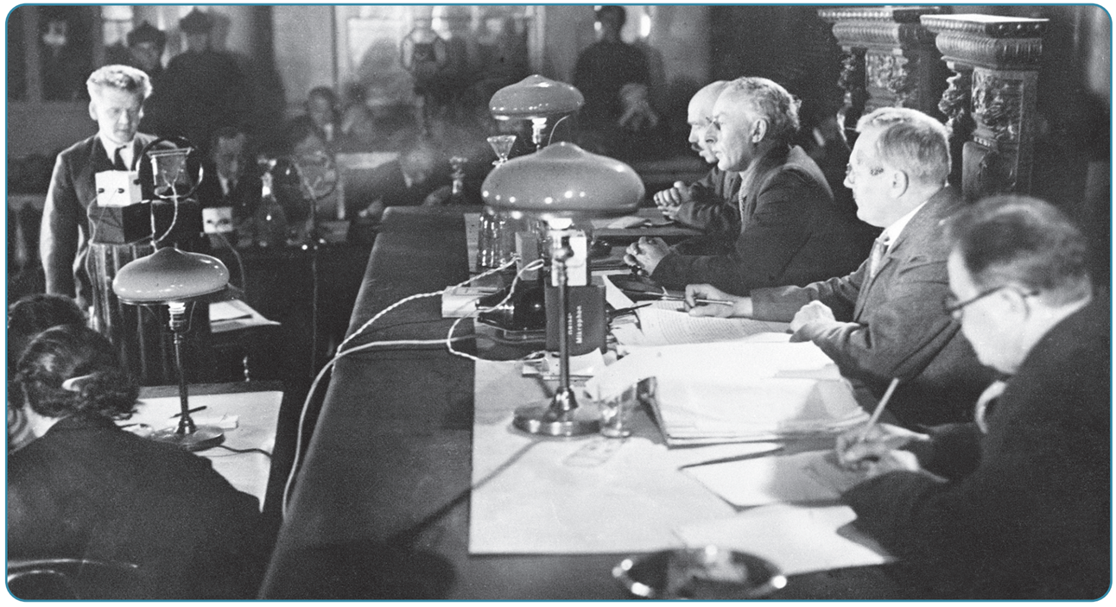
Strand Three: The History of Europe and the Wider World
Chapter Twenty-Two: Life in Communist Russia
Diagram taken from Artefact, 2nd Edition by Eimear Jenkinson and Gregg O'Neill (educate.ie)
@MsDoorley

Slide 35
Checkpoint pg. 300 (Artefact, 2nd Edition)
  Explain the following terms: collectivisation; gulags; Five-Year Plan.
  How was collectivisation carried out in the USSR?
  What happened under the (a) First, (b) Second and (c) Third Five Year Plans?
  Were Stalin's attempts to industrialise the USSR successful? Give reasons for your answer.
  What is a dictator?
  What was the NKVD and who did it target?
  What was a show trial? How did Stalin ensure the conviction of the defendants?
  What happened to the Red Army in 1937? Why did this happen?
  How did Stalin use terror to achieve total control of the USSR?
  Why do you think dictatorships need to use terror as a tactic?
Strand Three: The History of Europe and the Wider World
Chapter Twenty-Two: Life in Communist Russia
@MsDoorley

Slide 36
Checkpoint pg. 300 (Artefact, 2nd Edition)
  Collectivisation: the joining of small, unproductive farms together to create large, state-owned farms; Gulags: forced labour camps; Five-Year Plan: set of targets(and policies designed to meet them)over a period of five years.
  Workers would be hired to run state-owned farms or farmers could collectively own all the land and equipment. However, the kulaks refused to surrender their farms, and millions were sent to gulags.
  (a) First Five-Year Plan: focused on heavy industry and the production of coal, oil, steel and electricity. The targets were mostly unrealistic but improvements were made; (b) Second Five-Year Plan: continued focus on industry but also on transport and the production of consumer goods. The Moscow underground was built, as were canal and rail links; (c) Third Five-Year Plan: was cut short due to the 1941 invasion by Germany. Instead ,the focus switched to the production of arms and ammunition.
  Yes, Stalin’s attempts to industrialise the USSR were successful, as coal, steel and oil output increased. It also led to the building of the Moscow underground, canals and rail links, which were key to transporting goods.
  Dictator: someone who has gained almost total control over their country and uses a variety of means, especially terror and propaganda, to hold on to power.
  The NKVD was the name of the reorganised secret police force that replaced the Cheka. It targeted ‘enemies of the state’.
Strand Three: The History of Europe and the Wider World
Chapter Twenty-Two: Life in Communist Russia
@MsDoorley

Slide 37
Checkpoint pg. 300 (Artefact, 2nd Edition)
7. Show trial: a staged trial held in public to influence popular opinion; Stalin ensured convictions by having the defendants tortured for their confessions. Their families were also threatened with arrest and torture.
8. The Red Army was purged in 1937 because Stalin did not trust anyone who had served under Trotsky, the Red Army’s previous leader.
9. Stalin used terror to achieve total control of the USSR through the use of the NKVD, gulags for enemies of the state, the show trials and purges of the Red Army and his own party.
10. Dictatorships need to use terror as a tactic so as to prevent any uprisings against them and ensure that they keep control of their country.
Strand Three: The History of Europe and the Wider World
Chapter Twenty-Two: Life in Communist Russia
@MsDoorley

Slide 38
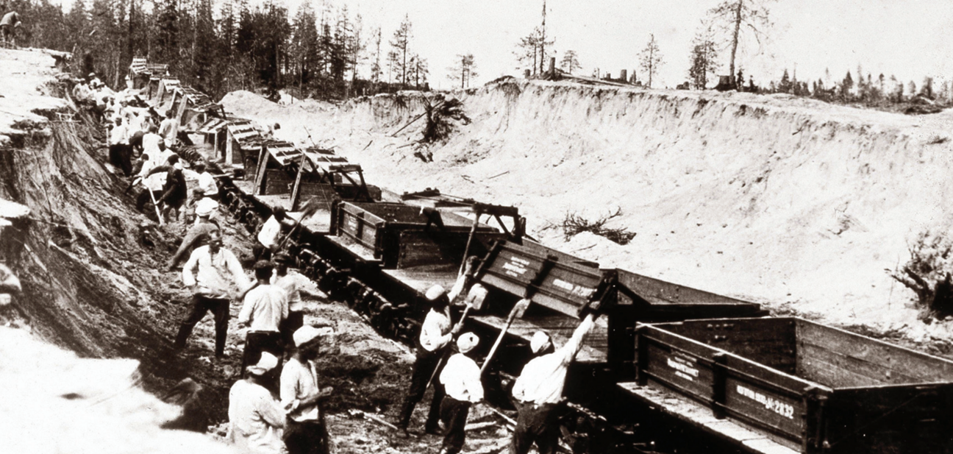
Strand Three: The History of Europe and the Wider World
Chapter Twenty-Two: Life in Communist Russia
Diagram taken from Artefact, 2nd Edition by Eimear Jenkinson and Gregg O'Neill (educate.ie)
@MsDoorley

Slide 39
Propaganda
Stalin used propaganda to go hand-in-hand with terror in order to keep control of the USSR and its messages loomed large in people’s lives.
  The Communist newspaper was called Pravda (‘Truth’). In it, Stalin was praised and his rivals were criticised.
  Posters and works of art had to present the idea of a successful country with a happy workforce, demonstrating the greatness of the USSR (and the success of communism).
  Stalin had become a godlike figure as he created a 'cult of personality' around himself: posters and statues of him were everywhere in the USSR.
  Cities and streets were named after Stalin, for example Stalingrad (modern day Volgograd) and Stalinsk (modern day Novokuznetsk). Just like Leningrad (Petrograd or St Petersburg).
  Stalin was referred to as ‘the Brilliant Genius of Humanity’ and ‘the Father of Nations’.
  Those declared enemies of the state or killed in purges were sometimes even airbrushed out of photographs or removed from all records, as if they had never existed.
Strand Three: The History of Europe and the Wider World
Chapter Twenty-Two: Life in Communist Russia
@MsDoorley

Slide 40
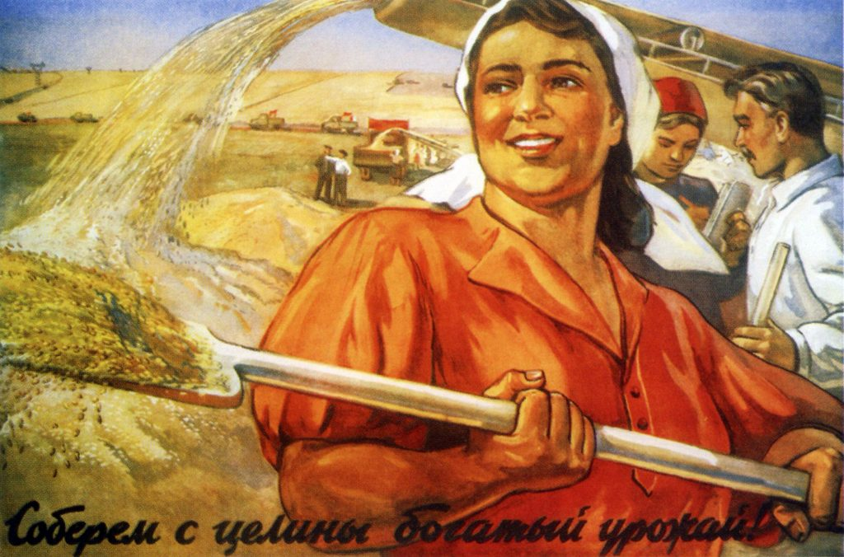
Strand Three: The History of Europe and the Wider World
Chapter Twenty-Two: Life in Communist Russia
Diagram taken from Artefact, 2nd Edition by Eimear Jenkinson and Gregg O'Neill (educate.ie)
@MsDoorley

Slide 41
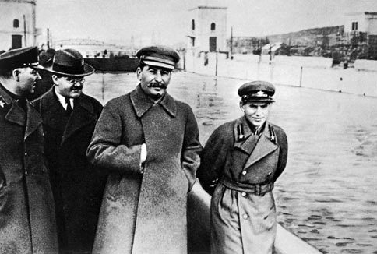
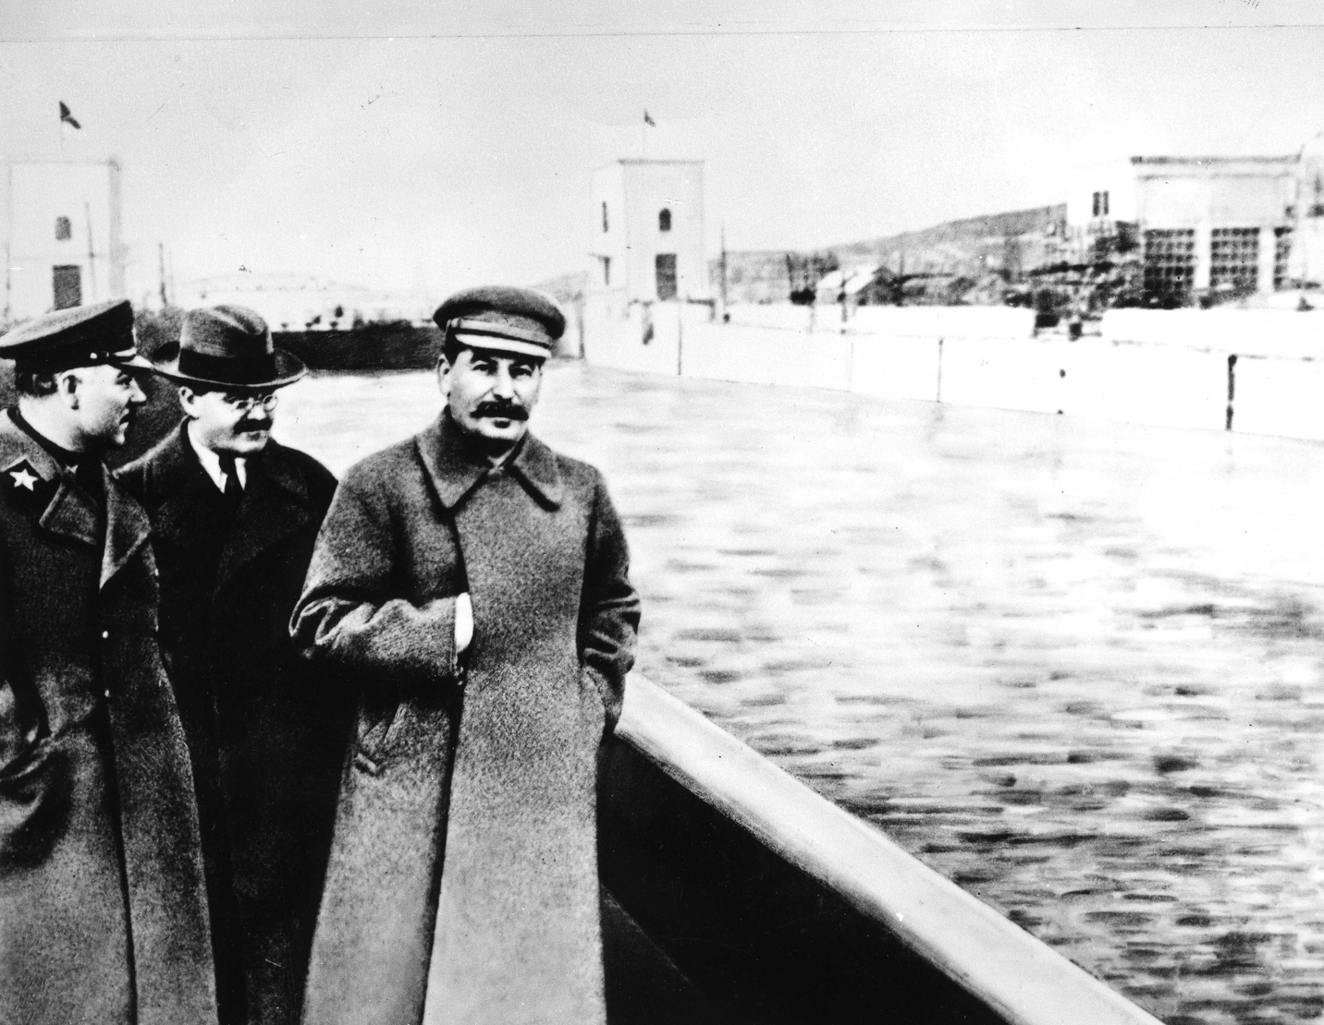
Strand Three: The History of Europe and the Wider World
Chapter Twenty-Two: Life in Communist Russia
Diagram taken from Artefact, 2nd Edition by Eimear Jenkinson and Gregg O'Neill (educate.ie)
@MsDoorley

Slide 42
Education
  Propaganda was also used in schools – textbooks were rewritten to make Stalin’s role in the October Revolution and the Russian Civil War look more impressive. The roles of others, such as Trotsky, were downplayed or erased completely.
  Stalin made attending school compulsory to combat illiteracy and improve efficiency in the workplace. He also brought back exams that had been removed during Lenin’s rule.
  Before the revolution, literacy rates in Russia were roughly 28% overall (only 13% for women). Records claim that literacy rates soared to 56% in 1924 and 75% by 1937.
  Children were to learn how to be of the greatest possible service to their country.
  Youth organisations such as the Young Communists and the Komsomol were founded. Both worked to convince the youth of the importance of communism so that they would ensure it continued into future generations.
Strand Three: The History of Europe and the Wider World
Chapter Twenty-Two: Life in Communist Russia
@MsDoorley

Slide 43
Women’s Lives Under Stalin
  Stalin was more conservative than Lenin; he wanted the birth rate to be high because the USSR would need many children to build up its workforce and army.
  Parents received a child allowance from the state but only if married.
  Divorce was discouraged and contraception was made illegal again.
  Women who had six or more children were paid 2,000 roubles per year for five years as a reward; mothers of nine or more also received a medal.
  In 1935, women made up 44% of the Soviet workforce; by 1937 it was 50%.
Strand Three: The History of Europe and the Wider World
Chapter Twenty-Two: Life in Communist Russia
@MsDoorley

Slide 44
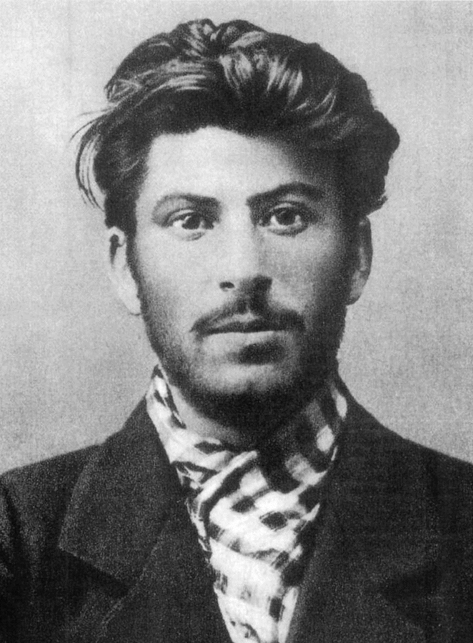
Josef Stalin, 1878-1953
Josef Stalin was born in Gori, Georgia. At 16 he was in training to be a priest, but was expelled for his radical Marxist ideas. He joined the Bolshevik Party, as a result of which he was arrested and set to Siberia in 1904. He joined the Bolshevik central committee in 1912. He had a minor role in the October Revolution of 1917. During the Russian Civil War, he organised the 'Red Terror'. Stalin became the Communist Party general secretary in 1922 and gradually gained power. When Lenin died in 1924, Stalin seized power. He organised the combining of small farms into larger 'collective farms'. In the 1930s, Stalin held purgers of anyone who was a threat to his power, including the Red Army. The show trials were intended to frighten his opponents. In August 1939, Stalin signed a 'non-aggression pact' with Germany. However, after Germany invaded the Soviet Union in 1941, he entered an alliance with Britain and France against the Germans. After the war, the USSR emerged as a superpower. Stalin died in 1953 and is buried in the Kremlin Wall Necropolis in Moscow.
Strand Three: The History of Europe and the Wider World
Chapter Thirteen: The French Revolution
Diagram taken from Artefact, 2nd Edition by Eimear Jenkinson and Gregg O'Neill (educate.ie)
@MsDoorley

Slide 45
Checkpoint pg. 302 (Artefact, 2nd Edition)
  What is propaganda? Give three examples of how it was used by Stalin.
  Why do you think that dictatorships need to use propaganda?
  Name two ways that Stalin’s educational policies benefited the USSR.
  What policies did Stalin introduce to encourage large families?
  Do you think that Stalin’s ideas about women reflected those of Marx? Explain your answer.
Strand Three: The History of Europe and the Wider World
Chapter Twenty-Two: Life in Communist Russia
@MsDoorley

Slide 46
Checkpoint pg. 302 (Artefact, 2nd Edition)
  Propaganda is information that has been designed to influence the attitudes and behaviours of the general public. The Communist Party newspaper called Pravda (‘Truth’); posters and works of art; Stalin’s name on cities and streets; the total erasure of people who had fallen out of favour; the show trials.
  Dictators need to use propaganda so that their failings are not shown, and so as to convince people that they are a good and strong leader. Propaganda also presents the country in a falsely positive light to other countries.
  Stalin made school compulsory to combat illiteracy and improve efficiency in the workplace; exams were also brought back. Before the revolution, literacy rates in Russia were roughly 28% overall (but only 13% for women).Records claim that overall literacy rates soared to 56% in 1924 and to 75% by 1937.
  Parents received a child allowance from the state, but only if married. Divorce was discouraged and contraception was made illegal again. Women who had six or more children were paid 2,000 roubles per year for five years as a reward from the state. Mothers of nine or more children received a medal.
  Students may answer yes or no, once they back their opinion up with a reason based on what they have learned, for example: ‘Yes’, because Marx believed in equality amongst people, and Stalin was providing women with the ability to continue working, even with children; or ‘No’, because some of the important advances towards equality made under Lenin were reversed and women’s potential was again regarded in terms of their capacity to produce and raise large families. Contraception was banned under Stalin and divorce was made difficult to achieve.
Strand Three: The History of Europe and the Wider World
Chapter Twenty-Two: Life in Communist Russia
@MsDoorley

Slide 47
1917-1939
Chapter 22
22.4: SUMMARY
22.4: summary
Strand Three: The History of Europe and the Wider World
@MsDoorley

Slide 48
In this chapter, we have learned that...
  Vladimir Lenin created the first communist state after the October Revolution of 1917. His political party was called the Bolsheviks.
  Lenin did not name a successor. When he died, a power struggle took place between Kamanev, Zinoviev, Bukharin, Trotsky and Stalin. Josef Stalin rose to power.
  Stalin aimed to industrialise and modernise the USSR. He began a method called collectivisation. He also created three Five Year Plans to increase production in the USSR.
  Stalin used terror tactics to intimidate the Russian people. For example; the purges, the NKVD, the gulags and the show trials. He used propaganda to control information and to project a strong, forward looking image of the USSR to the outside world. Examples included: posters and statues, youth groups, the party newspaper Pravda, rewriting history textbooks and altered photographs and records.
  Under Stalin, school was made compulsory and literacy rates soared.
  Earlier moves towards equality for Russian women were limited under Stalin. Divorce was discouraged, and contraception and abortion was made illegal once more, as Stalin wanted a high birth rate for his workforce and army.
Strand Three: The History of Europe and the Wider World
Chapter Twenty-Two: Life in Communist Russia
@MsDoorley

Slide 49
Reflecting on... Life in Communist Russia
The October Revolution of 1917 created the world's first communist state. Lenin and Stalin set up a system to be a beacon to the rest of the world and encourage the spread of communism. The USSR industrialised rapidly and access to education and health care was improved. However, its people lived in fear of the state. The conflict between communism and other political ideologies - first fascism and later Western democracy - would dominate the twentieth century.
Strand Three: The History of Europe and the Wider World
Chapter Twenty-Two: Life in Communist Russia
@MsDoorley

Slide 50
Examination Questions
2022 SEC Q4
Strand Three: The History of Europe and the Wider World
Chapter Twenty-Two: Life in Communist Russia
@MsDoorley

Slide 51
Project
Guidelines:
  Length: The depth of your project should reflect about 2-3 weeks of work.
  Sources: Use at least three different sources for your research. These can be books, scholarly articles, or reputable online resources.
  Citations: All information and images that are not your own should be properly cited.
  Mediums: You may choose to present your project in one of the following ways:
    Poster: Your poster should be informative and visually engaging.
    Minecraft or Lego Model: If choosing this option, please also include a brief report explaining your model.
    Painting/Drawing: Your artwork should be accompanied by a description.
    Recycled Materials: Create your model using recycled materials and provide an explanation of your creative process.
Assessment:
Your projects will be assessed based on:
  Research and Content
  Creativity and Presentation
  Understanding of Context
  Adherence to Guidelines
Strand Three: The History of Europe and the Wider World
Chapter Twenty-Two: Life in Communist Russia
@MsDoorley

Slide 52
Project
Historical Sites
Historical Figures
Winter Palace, St. Petersburg, Russia
Kremlin, Moscow, Russia
Butovo Firing Range, Moscow, Russia
Lenin's Mausoleum, Moscow, Russia
Gulag Museum, Moscow, Russia
Vladimir Lenin
Josef Stalin
Lavrentiy Beria
Nikita Khrushchev
Leon Trotsky
Dora Kaplan
Lyudmila Pavlichenko
Trofim Lysenko
Strand Three: The History of Europe and the Wider World
Chapter Twenty-Two: Life in Communist Russia
@MsDoorley

